Slide 1
The road ahead – perspectives for family medicine
Professor Amanda Howe
President- Elect WONCA
Notes:
When you set out on a journey it is usual to know why you want to go, and where you are going to. Then you have to plan how to get there, orat least to put the GPS co-ordinates into the SatNav! And sometimes, on a long journey, when you are tired, and the signal gets lost, and the road is not as you expected, you have to stop, and try to understand where you have got to – and how you got there – to make sure you don’t start to go backwards from where you came, or make a wrong turning and waste your time and energy which is very precious. So that is what I want to do today – look back at the road we have already travelled, so that we can be clear about the direction we are travelling in, and hopefully to help us remember our destination and the choices we can make to get there.

Slide 2
Romania’s journey into family medicine
1999 – independent contractor status
2006 – need to build larger group practices, multidisciplinary teams, structured professional development programmes, better information collection and analysis, and more research in community settings
Future risks of medical migration and queries over commitment to FM as a speciality in the system.
Notes:
I found a paper, written in 2006 by authors from the National Centre for Studies in Family Medicine, which outlined the road you had taken from 1999 into an independent contractor status, and forecast 5 key areas for the next steps: group practices, multidisciplinary teams, structured professional development programmes, better information collection and analysis, and more research in community settings. They also noted some uncertainties about entering the European Community, with potential patient & doctor migration, both in & out of the country. Dr. Andrea Abăităncei, Dr. Marius Mărginean, Dr. Cristina Isar http://www.cnsmf.ro Family medicine in Romania - history and perspectives

Slide 3
Current problems
Low investment (health < 6% GDP)
Lack of control over quality and background of those who are allowed to work as family medicine practitioners
No minimum pricing of contracts and services
Practice closures campaign presents 20,000 signatures to Downing Street
Notes:
Since then, of course, the road has not always been smooth – I know Romania still devotes less than 6% of its GDP to health, which is at the bottom end of European standards, and that the percentage allocated to FM within that is also relatively low. A paper from your own organization in 2011, echoed by Rich Robert’s report of his visit that same year, shows a path which many countries have also had to tread - where much good work has been done towards strengthening the FM speciality, but it is weakened by political imperatives which downgrade the entry criteria and relabel other doctors as competent to work in FM when they have not undertaken the our FM training. There is also sometimes destabilisation of the role of FM in the health care system if there is no minimum pricing for the contract or consistency over time in the working conditions. The same picture is true of GPs / FM practitioners in the U.K. – we have recently seen our government attempt to withdraw the Minimum Practice Income Guarantee, precipitating potential closures for at least 100 practices, and significant income loss for nearly 200 more. And I know that yesterday you have been discussing other examples of tensions within countries and with changing political contexts about how gains we think we have made in family medicine can fall way from us again.

Slide 4
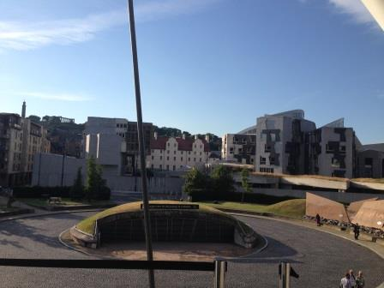
Notes:
So what does this teach us? That this is a modern well made road with infrastructure that has so much investment in it that the country cannot see it fail? Or that we are in a time of instability, where even roads that were valued for the access they gave are prone to landslips and poor upkeep? And most importantly what does this teach us for the future?
I could carry on with this metaphor, but would like to come to people and evidence from our own context. A brief SWOT analysis I think shows the following:

Slide 5
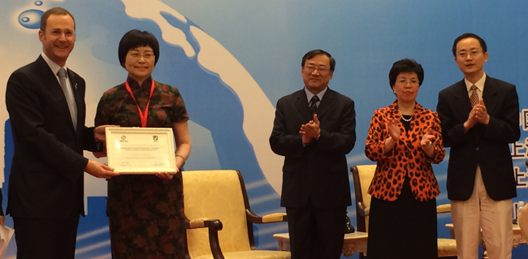
SWOT analysis
Strengths
Being a speciality
National / international recognition
Values and focus
Patients like FM!
Great colleagues
Notes:
A brief SWOT analysis I think shows the following:
Our strengths are that FM IS now established in many countries – WONCA has over 130 member organizations in more than 100 countries, and all these fulfil the criteria of having developed FM as a ‘proper’ speciality, with postgraduate training and national organizations such as your own. We have got a university presence in many medical schools, and a growing body of primary care researchers and research. We have got some international political momentum, including (through the efforts of the current and previous Executive, particularly our Presidents and Dr Donald Li) winning the recognition for family medicine by the current WHO Secretary General, Dr Margaret Chan. Our values and focus – on patients, their needs, their lifelong care, and their personhood, is a huge strength, which is upheld and enacted in our clinics is a moral force which all need and many respect. And we have a cadre of wonderful colleagues, including those early in their careers, who have a passion for the discipline, its patients, and its future.
B

Slide 6
Weaknesses
Uncertain status
Problems recruiting good candidates
Mismatch between workload and need
Under – resourcing
Diversity and dispersion
One voice?
-> constant attrition ….
Notes:
But weaknesses ? A new speciality with uncertain status – this gives us difficulties with recruitment; mismatched hopes and realities, so when under resourced we cannot meet our own or our patients’ expectations; we are a very diverse community, and it can be hard to unite us all when working conditions are very different – urban deprivation, rural isolation, large or small teams, and power struggles with other disciplines. These are common problems, and they may leave us open to risk when added to some of the threats outlined earlier - >

Slide 7
Threats to our wellbeing
Burnout
Guilt
Loss of confidence
Disempowerment
Blaming self or each other
Depression
Notes:
There are also threats to us psychologically – threats to our resilience, to turn us back into victims, or to make us over defensive and to ‘burnout’. We know that doctors are at risk of ill health due to mental stress – the more idealistic become guilty that they cannot meet all the needs to the highest standard: the insecure feel others do not respect their work, their confidence diminishes, they feel out of control and may then become depressed: the doctor who feels proud and sees their status or income or standard of work diminish, can be come resentful and angry – none of these are good for us, or for our patients, or for our professional profile. So there is a risk of a ‘vicious circle’ or a ‘perfect storm’ where one problem makes another worse…
But

Slide 8
New opportunities
Shared experiences,
ideas and analysis
WONCA Working Parties
Special interest groups
Research and shared analyses
See www.globalfamilydoctor.com
Notes:
But does this give us some new opportunities? I am going to talk about this at the level of you as individuals, your teams, your organisations, and the possibility of help through WONCA. This conference in itself is a wonderful opportunity, and I was very sorry not to be able to attend more of it – but yesterday I had to be in my own WONCA member organisation’s Council, where I am an officer, leading key discussions on GP Workforce; GP careers: working in quality of primary care: and also debating other themes such as securing more resources for the primary care sector. We have all accumulated a lot of expertise, and some countries have more resources than others. So one opportunity we have is to work together – sharing experiences, ideas, analysis and evidence.

Slide 9
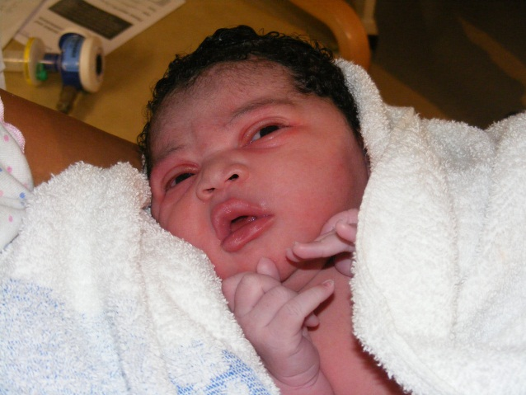
Remember where you want to go!
“a service that is comprehensive, accessible, focuses on a specific community, allows continuity over time, and is centred on the care of people not specific parts of their body or diseases”.
Notes:
As individuals, I would suggest that you strengthen your image of the destination, and how much you want to get there. The European Definition (http://www.woncaeurope.org/sites/default/files/documents/Definition%20EURACTshort%20version.pdf ) helps us to remember what it is we are aiming at – our patients help us to remember why we need to get there – and our Colleges and colleagues can then help us to consider how to get there.

Slide 10
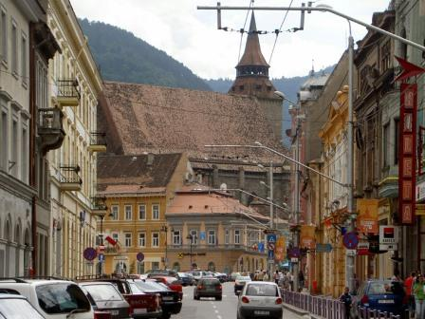
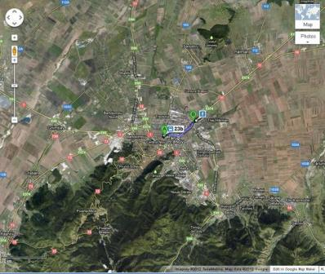
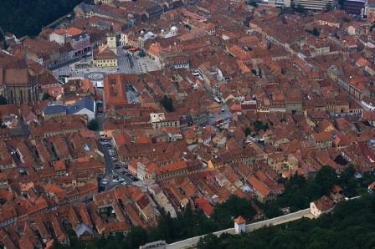
Get the bigger picture
Notes:
* But from the ground it is hard to see the horizon, or the direction - by coming up a level, looking more broadly, it may not be more attractive but we see the fuller picture, and the choices that are open to us. So let’s draw on our different teams – clinical, teaching, or networks through the SNMF. We can ask each other for advice – which road is easier, which is quicker, do we need a big tough car for lots of people or would a small unobtrusive eco-model slip through more easily to get someone across the line on our behalf.

Slide 11
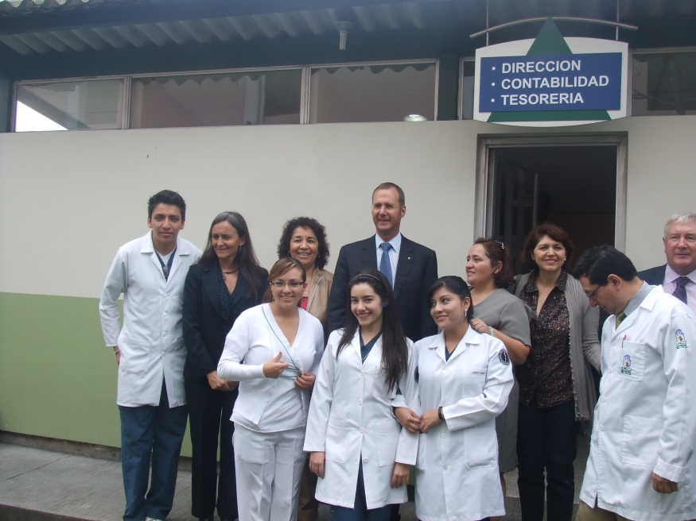
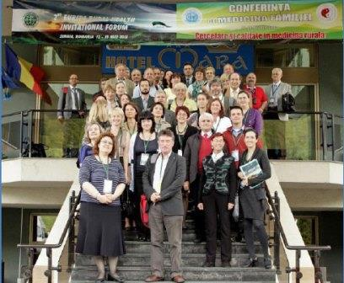
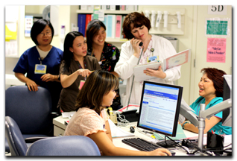
Use the team
Notes:
As teams – I think we need to do the same thing: adding some new energy, some additional goal, even a diversion to add to the variety of the journey can keep us enlivened, and a discussion about how to solve problems together can make the journey seem easier. Also, there is safety in numbers – a whole region’s FM doctors, an accumulation of evidence is much harder for bureaucrats to ignore, and can when well judged get positive media attention. This brings us of course to organizations – who can use their status to advocate, defend, or draw in other expertise to help them to make their case .
And that is the role of WONCA – to share, offer expertise, encouragement, and bring together the bigger picture. So can I help you, finally with your roadmap for the future? We have touched on some of this, but I shall summarise, again through the ‘journey’ metaphor….

Slide 12
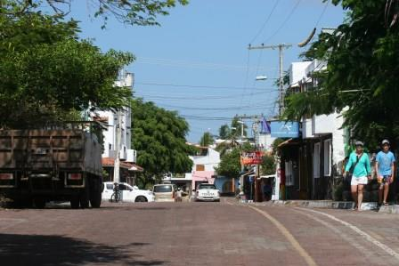
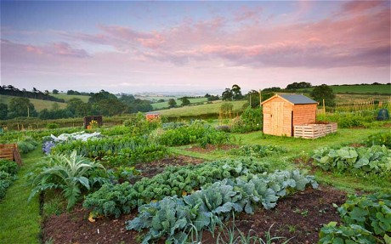
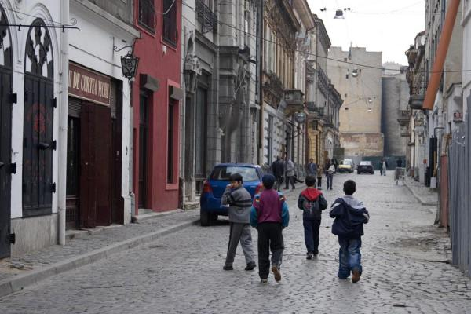
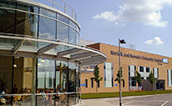
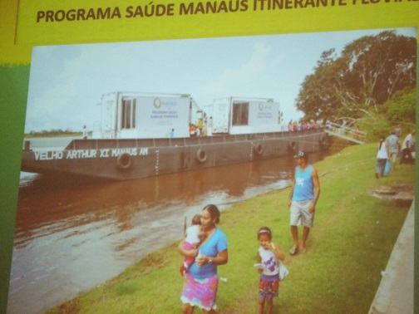
Notes:
The exact road you choose may not matter – it may be rural or urban: your patients may be professionals or the poor; it may be mainly clinical, or possibly in a university; but it needs to have the vision of what is good family medicine practice as both the journey and the destination.

Slide 13
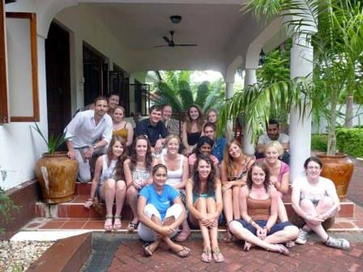
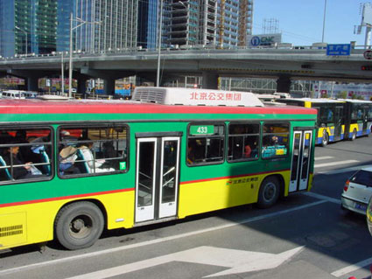
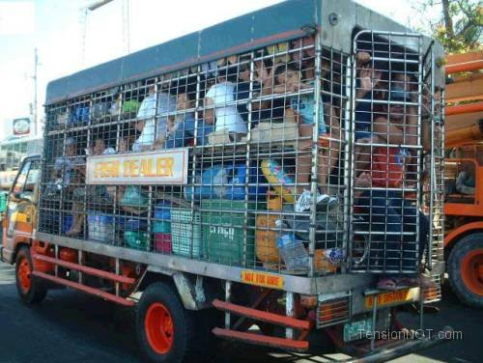
Top tips for your journey
Learn what you need to know to do the job well
Equip yourself properly and insist on help if needed
Take care of yourself
Consider travelling with others
…Especially younger doctors – they may not know the way but they are enthusiastic and move very quickly!
And watch out for common dangers ……
Notes:
To make a safe journey,
You must first learn to drive the car – learn with a good teacher, someone who already has a clear sense of the goal and what matters.
Keep your goal in mind, and make sure you have all the equipment you need to get there – knowledge, skills, electronic communications, maps, insurance etc. If any of this is missing, you may not make the journey with your patient effectively – try to get what you need yourself, and if it is not available or forthcoming then say so
Take care of yourself – plan your music, your rest breaks, your companions, and your route. There will not be only one route – you can take your time, you can try different cars and roads, but excessive speed or risk will lead you into danger.
If possible, do not travel alone. Get advice, and perhaps choose to go together. Too often as FM practitioners, we are so used to doing everything for all our patients that we forget to divide the work, or ask for help, or consider if there might be a better way – and a good team can make the journey safer, quicker and less onerous.
When you have learned how to make your own journeys safely, please take some time to teach others – otherwise they will not be able to travel the same road, or help with those who need a lift – and that may include you when you are older! They will also be interested in the journey, which will make it more enjoyable.

Slide 14
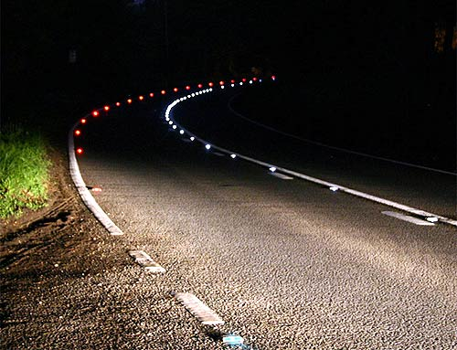
Notes:
And when everyone else is sleeping and you are still on that long drive of being a family doctor, with your own professional journey within the other journeys of so many patients, then you may want to listen to something less like a lecture , something a bit more poetic – so here is a closing message, from one of your own poets –
. … take the poem in your arms, pick it up with the hands you have written it with and leave. … go to deliver it personally. You were right (you've been right all along): the addressee, the address, the contents should by all means be kept secret, yet it should reach its destination all the same ă) You have learned at long last how it's done: you are supposed to write to each and every one, yet deliver the message in person. Be the courier of your own message (as long as it's yours and you've got someone to tell it to), be not ashamed. Write it by heart …. and leave. Bogdan Ghiu Translated from the Romanian by Florin Bican
- See more at:
http://www.asymptotejournal.com/article.php?cat=Special_Feature&id=76&curr_index=94&curPage=Special_Feature

